Slide 1
Firebase SOP
Firebase Account Creation & App Creation SOP

Slide 2
Create Google Account
Open Google Account Signup page
Enter name, username, and password
Verify mobile number with OTP
Complete recovery email and security setup

Slide 3
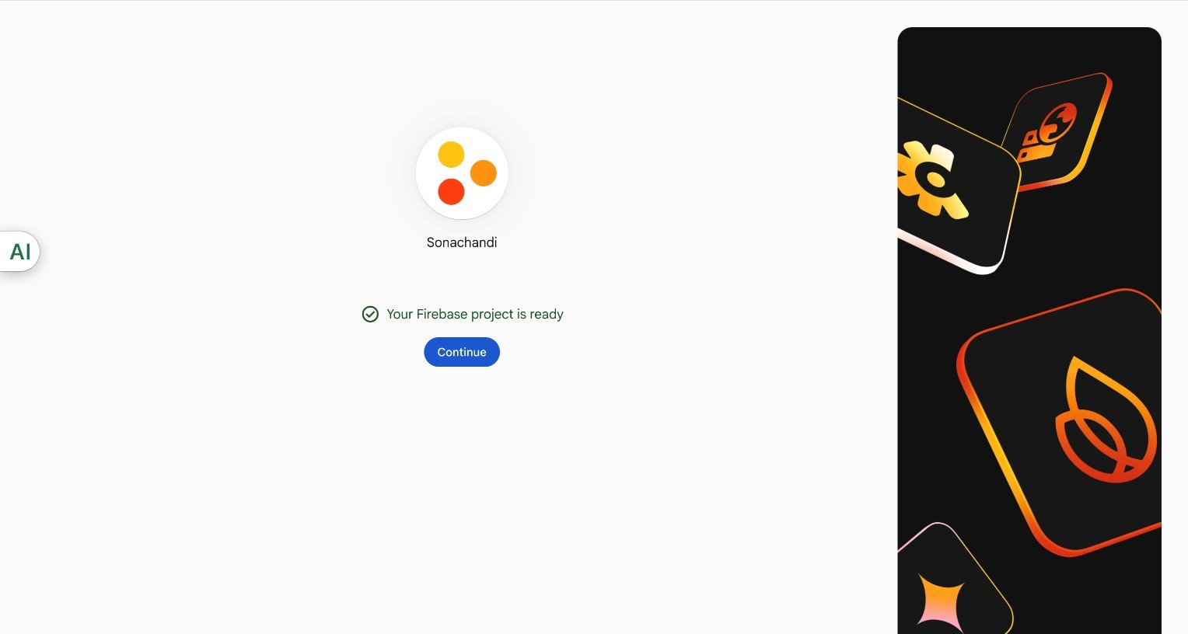
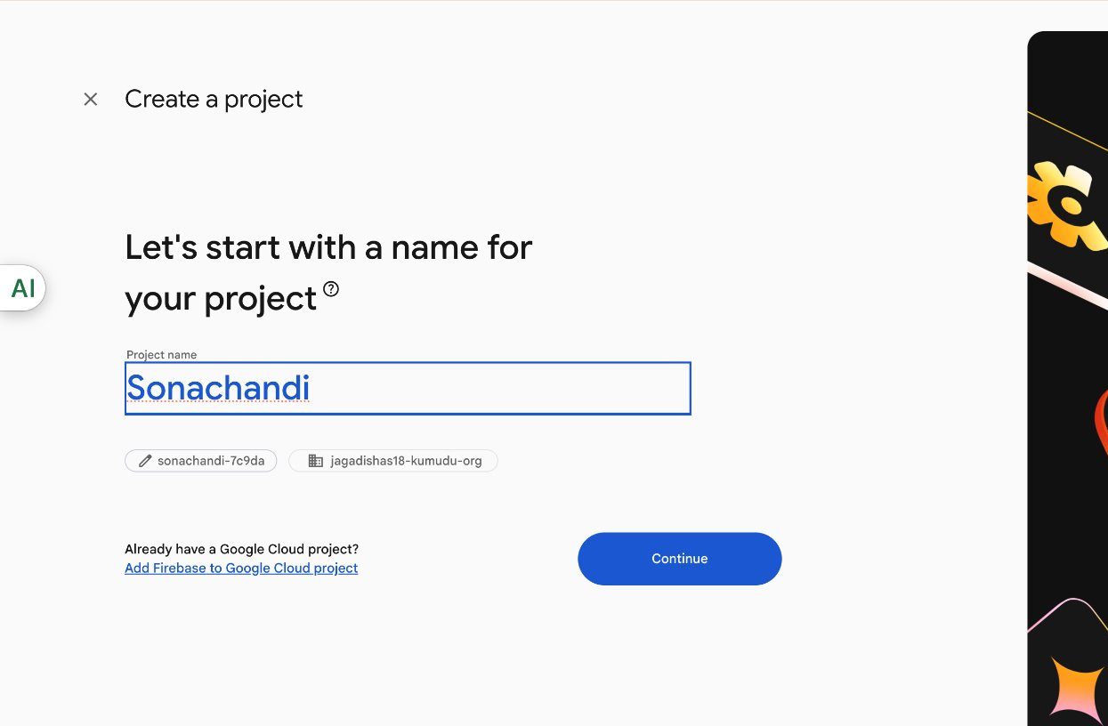
Create Firebase Project
Open Firebase Console
Login with Google account
Click 'Create a Project'
Enable Google Analytics (recommended)
Click 'Create Project'

Slide 4
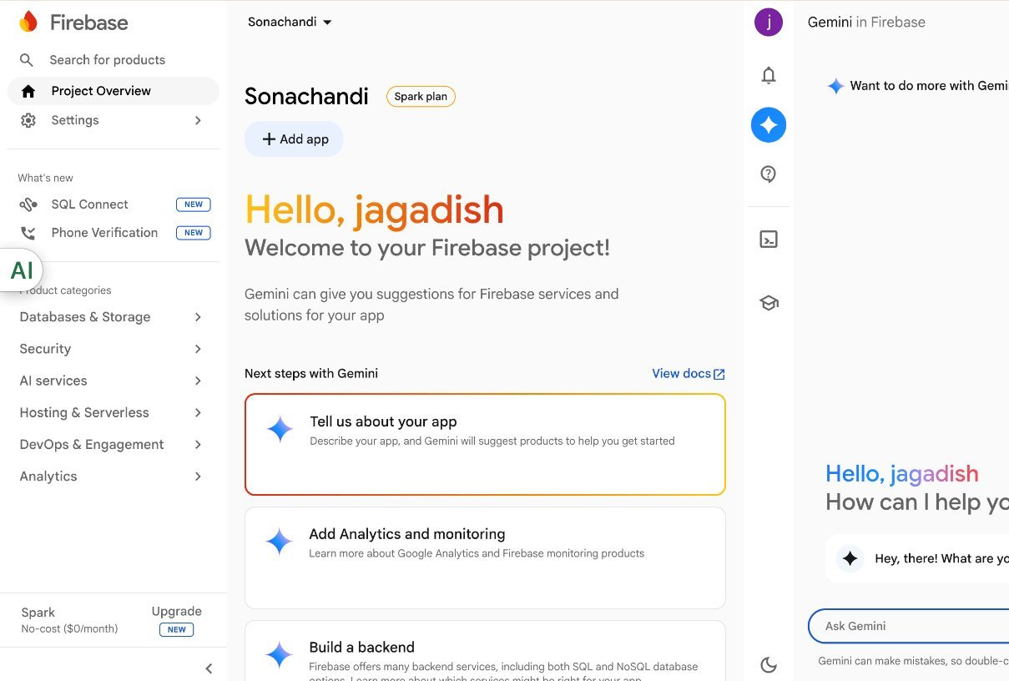
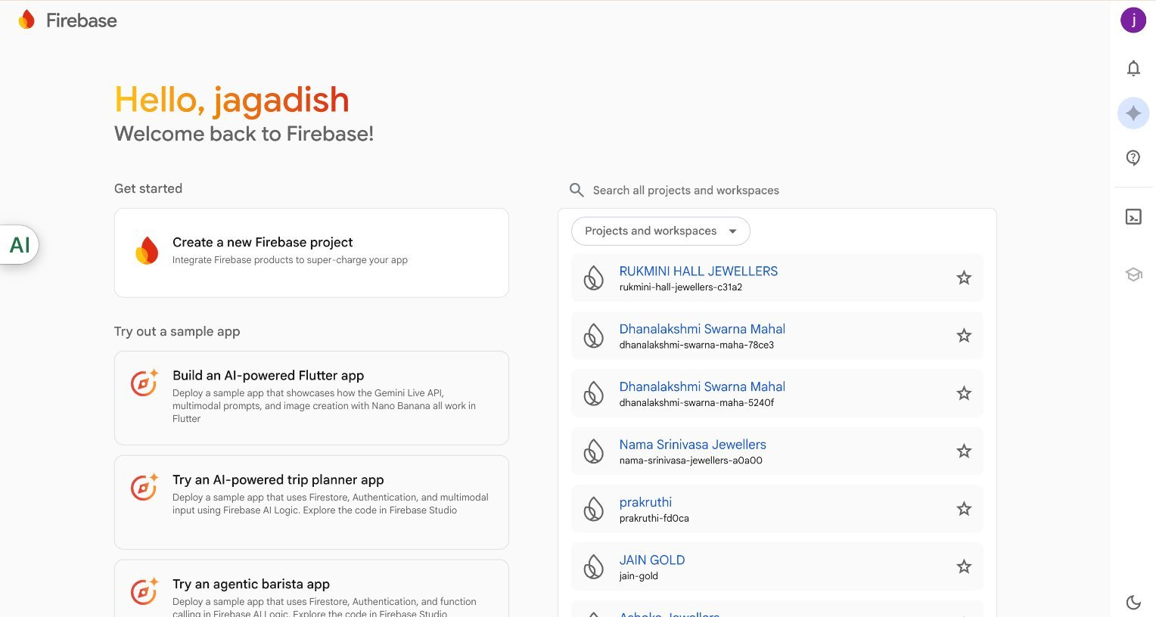
Add Android App
Click Android icon in Firebase dashboard
Enter Android package name
Register App
Download google-services.json
Place file inside android/app/

Slide 5
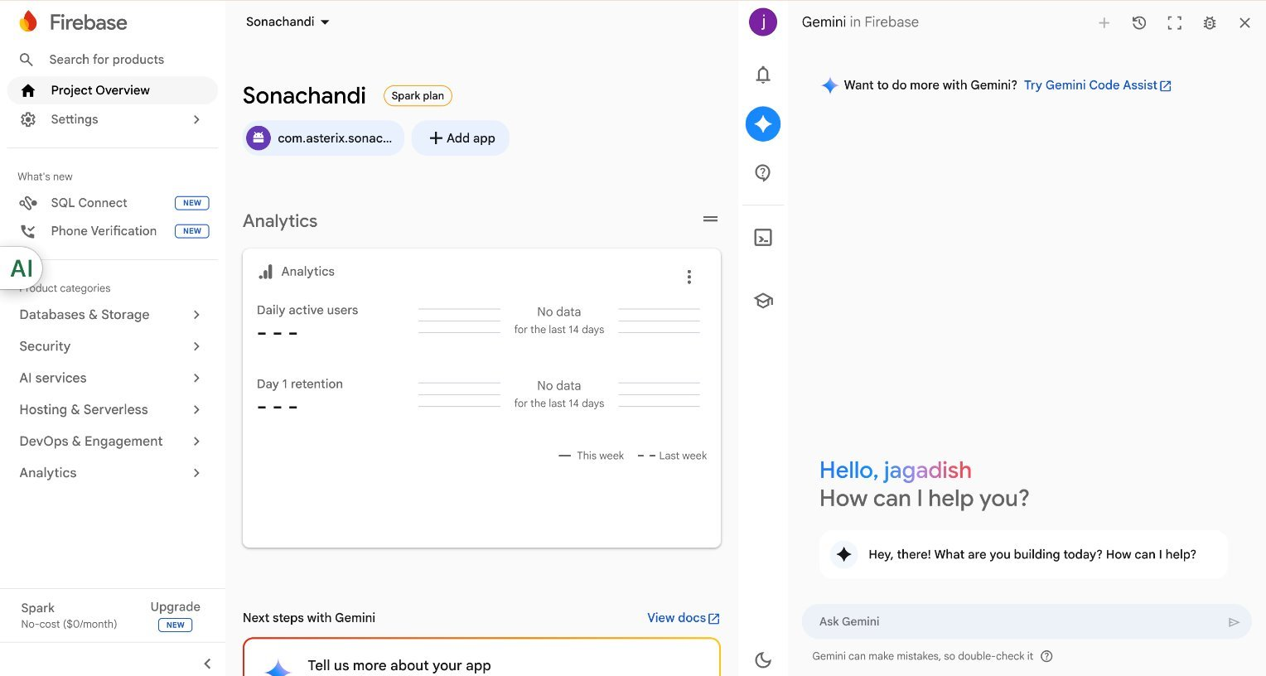
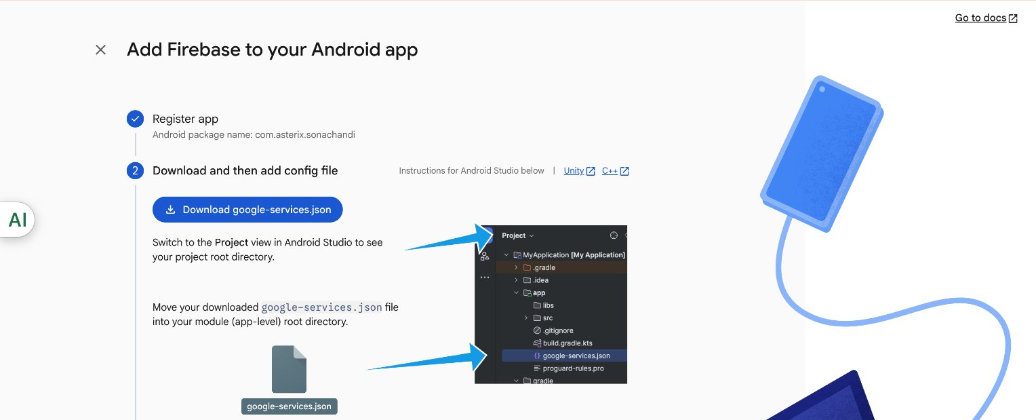
Add iOS App
Click iOS icon in Firebase dashboard
Enter iOS Bundle ID
Register App
Download GoogleService-Info.plist
Place file inside ios/

Slide 6
Install Firebase SDK
Install firebase package using npm
Configure firebase.js file
Add Firebase SDK configuration
Initialize Firebase app

Slide 7
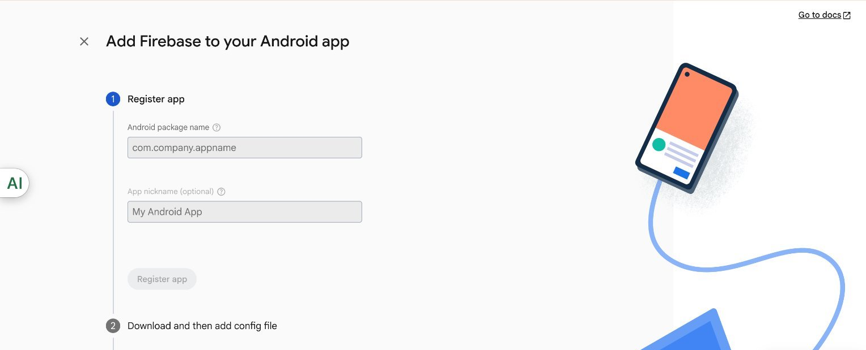
Enable Firebase Services
Enable Authentication
Create Firestore Database
Enable Storage
Choose Mumbai region (asia-south1)

Slide 8
Generate SHA-1 Key
Run keytool command
Use default password: android
Copy SHA-1 key
Add SHA-1 in Firebase Project Settings

Slide 9
Push Notifications
Open Firebase Cloud Messaging
Generate Server Key
Generate Sender ID
Use for notification integration

Slide 10
Firebase Hosting
Install firebase-tools CLI
Login using firebase login
Run firebase init
Deploy using firebase deploy

Slide 11
Security Best Practices
Use Firestore security rules
Enable App Check
Restrict storage access
Enable billing alerts

Slide 12
Useful Links
https://firebase.google.com/docs
https://console.firebase.google.com/
https://firebase.google.com/docs/web/setup

